Slide 1



ASP.NET Razor Engine
ASP.NET MVC
Introduction
SoftUni Team
Technical Trainers
Software University
http://softuni.bg

Slide 2
Have a Question?
sli.do #CSharpWeb

Slide 3
Table of Contents
Layouts
Partial Views
Html helper templates
Toolbox for HTML and Bootstrap

Slide 4
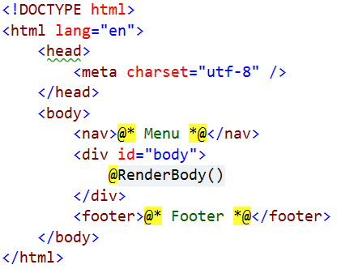
Layout
Defines a common site template
Razor view engine renders content inside-out
First the view is redered, then the layout
@RenderBody()
Indicates where the view content should be placed when rendering

Slide 5
Views and Layouts
Views don't need to specify layout since their default layout is set in their _ViewStart file:
~/Views/_ViewStart.cshtml (code for all views)
Each view can specify custom layout pages
Views without layout:
@{
Layout = "~/Views/Shared/_UncommonLayout.cshtml";
}
@{
Layout = null;
}

Slide 6
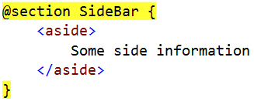
Sections
You can have one or more "sections" (optional)
They are defined in the views:
And may be rendered anywhere in the layout page using the method RenderSection()
@RenderSection(string name, bool required)
If the section is required and not defined, an exception will be thrown (IsSectionDefined())

Slide 7
Partial Views
Partial views render portions of a page
Reuse pieces of a view
Html helpers – Partial(), and Action()
Razor partial views are still .cshtml files
To annotate that an action from the controller should not be called outside of the application put [ChildActionOnly]

Slide 8

Display & Editor Templates

Slide 9

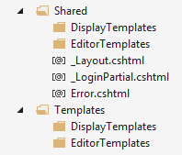
Templates
ASP.NET MVC comes with helper methods
DisplayFor(), DisplayForModel()
EditorFor(), EditorForModel()
There are default implementations
Can be configured easily
Create folders "DisplayTemplates" and "EditorTemplates" in the “Views/Shared" folder or in the "Views/{Controller}" folder

Slide 10
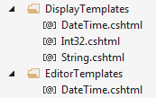
Custom Templates
In the two new folders create a view for each type you want
The file name must be the same as the type name
string -> String.cshtml
int -> Int32.cshtml
DateTime -> DateTime.cshtml
Student -> Student.cshtml
The name of the files must reflect the data types and the @model in them

Slide 11

Custom Templates
The display / editor templates are normal view files
The framework will start using them instead of the default implementations
Example – String.cshtml
All strings will be in paragraph element and will have quotes surrounding them
DisplayFor(), EditorFor() - for properties in the model
DisplayForModel(), EditorForModel() – for the entire model

Slide 12

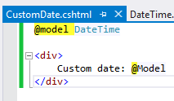
Custom Template Name
Sometimes you need two templates for one data type
Create the template with custom name
Decorate the property in the model with the [UIHint] attribute specifying the template name
You can set the name in the helpers too

Slide 13
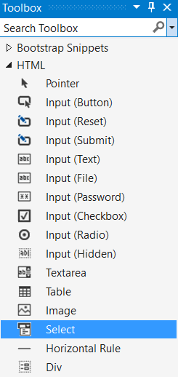
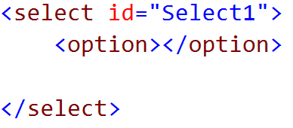
Toolbox for HTML and Bootstrap
Open View -> Toolbox from the menu bar.

Slide 14








ASP.NET Razor Engine
https://softuni.bg/courses/

Slide 15
License
This course (slides, examples, demos, videos, homework, etc.) is licensed under the "Creative Commons Attribution-NonCommercial-ShareAlike 4.0 International" license

Slide 16






Free Trainings @ Software University
Software University Foundation – softuni.org
Software University – High-Quality Education, Profession and Job for Software Developers
softuni.bg
Software University @ Facebook
facebook.com/SoftwareUniversity
Software University @ YouTube
youtube.com/SoftwareUniversity
Software University Forums – forum.softuni.bg

